Slide 1
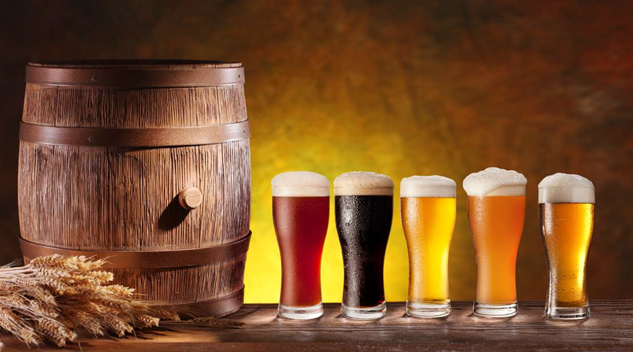
Data Analysis of US Craft Breweries
By: We’ve Got Data Analytics Corporation

Slide 2
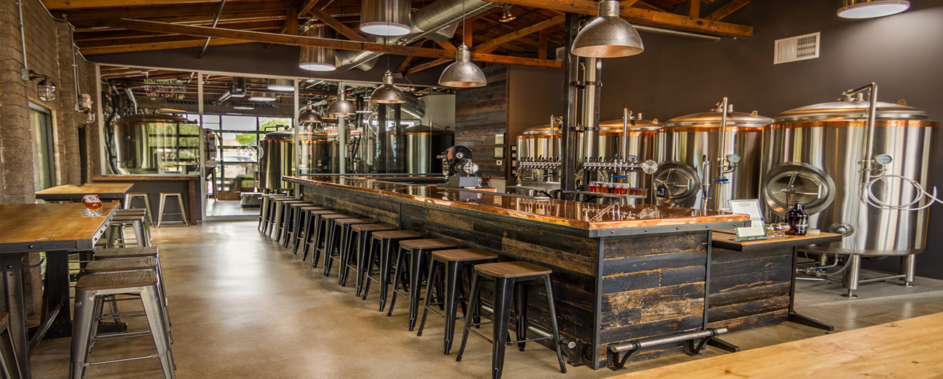
Jayson Barker Will Hinton Jeremy Simpson
Analytics Team

Slide 3
Introduction
You have requested our services in providing analysis of craft beers and brewery distributors of craft beers throughout the US. Your team has expressed interest in understanding the location of industry competitors, market saturation per state, along with assistance in determining the composition of your next beer product, according to alcohol content (ABV) and bitterness (IBU). The prepared analysis will accommodate you in addressing your needs. Based on this analysis along with follow-up discussions with your team and other relevant business partners, we feel that you will be well positioned to make a strong business decision for your organization.

Slide 4
Breweries by State
Top 10 Breweries by State
Bottom 10 Breweries by State
State | Breweries
CO | 47
CA | 39
MI | 32
OR | 29
TX | 28
PA | 25
MA | 23
WA | 23
IN | 22
WI | 20
State | Breweries
DC | 1
ND | 1
SD | 1
WV | 1
AR | 2
DE | 2
MS | 2
NV | 2
AL | 3
KS | 3
Notes:
TOLA beers because they’re in close proximity to houston

Slide 5
Beers and Breweries
Top 6 Beers and Breweries
Brewery ID | Beer | Beer ID | ABV | IBU | Style | Ounces | Brewery | City | State
1 | Get Together | 2692 | 0.045 | 50 | American IPA | 16 | NorthGate Brewing | Minneapolis | MN
1 | Maggie's Leap | 2691 | 0.049 | 26 | Milk / Sweet Stout | 16 | NorthGate Brewing | Minneapolis | MN
1 | Wall's End | 2690 | 0.048 | 19 | English Brown Ale | 16 | NorthGate Brewing | Minneapolis | MN
1 | Pumpion | 2689 | 0.06 | 38 | Pumpkin Ale | 16 | NorthGate Brewing | Minneapolis | MN
1 | Stronghold | 2688 | 0.06 | 25 | American Porter | 16 | NorthGate Brewing | Minneapolis | MN
1 | Parapet ESB | 2687 | 0.056 | 47 | Extra Special / Strong Bitter (ESB) | 16 | NorthGate Brewing | Minneapolis | MN
Notes:
TOLA beers because they’re in close proximity to houston

Slide 6
Beers and Breweries
Bottom 6 Beers and Breweries
Brewery ID | Beer | Beer ID | ABV | IBU | Style | Ounces | Brewery | City | State
556 | Pilsner Ukiah | 98 | 0.055 | NA | German Pilsener | 12 | Ukiah Brewing Company | Ukiah | CA
557 | Heinnieweisse Weissebier | 52 | 0.049 | NA | Hefeweizen | 12 | Butternuts Beer and Ale | Garrattsville | NY
557 | Snapperhead IPA | 51 | 0.068 | NA | American IPA | 12 | Butternuts Beer and Ale | Garrattsville | NY
557 | Moo Thunder Stout | 50 | 0.049 | NA | Milk / Sweet Stout | 12 | Butternuts Beer and Ale | Garrattsville | NY
557 | Porkslap Pale Ale | 49 | 0.043 | NA | American Pale Ale (APA) | 12 | Butternuts Beer and Ale | Garrattsville | NY
558 | Urban Wilderness Pale Ale | 30 | 0.049 | NA | English Pale Ale | 12 | Sleeping Lady Brewing Company | Anchorage | AK
Notes:
TOLA beers because they’re in close proximity to houston

Slide 7
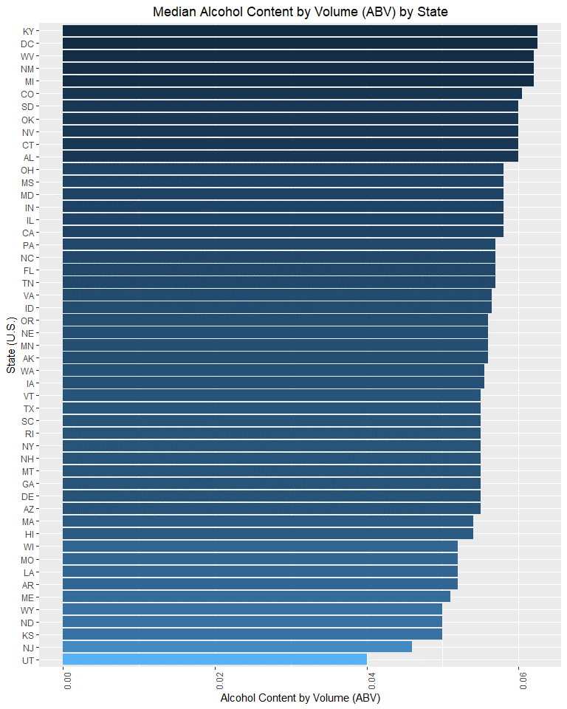
ABV

Slide 8
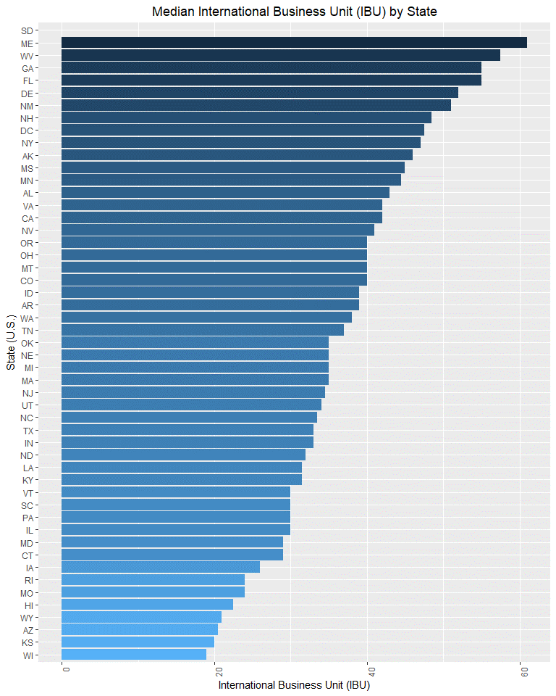
IBU

Slide 9
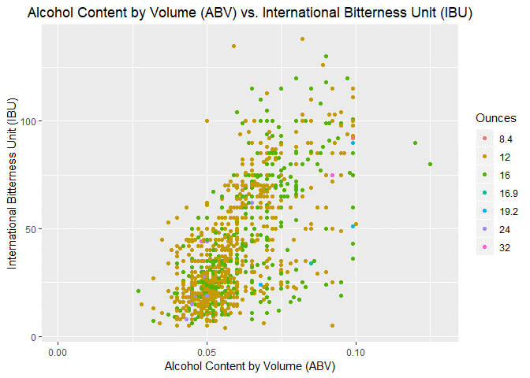
IBU

Slide 10
Recommendations
The following are our recommendations based the requested analysis:
1) Avoid constructing your new brewery in Colorado.
Our analysis indicates that the state is heavily saturated with breweries which would mean stiff competition. Our suggestion, is that you give strong consideration to exploring the markets in the states of Texas and Pennsylvania. These states have a mid-level concentration of breweries and appear to have some relative room for additional market growth and competition.
2) When developing your next beer product, please consider that our analysis strongly implies that a higher ABV will affect the bitterness of the beer. If bitterness is a key trait for your prospective product, it is probable that this can be achieved with a high ABV concentration. If you prefer that your product is less bitter, we suggest limiting the ABV to reasonable amounts.
3) Additionally we suggest considering locations of interest when determining the bitterness level of your proposed product. Our data shows that Oregon is the state with the highest concentration of bitter beers, yet the number of breweries is well below the number present in Colorado. This is either means there is a high demand for bitter beer, or a weak market for great tasting beer that has the potential to be further explored. At minimum we suggest further exploration.

